Slide 1
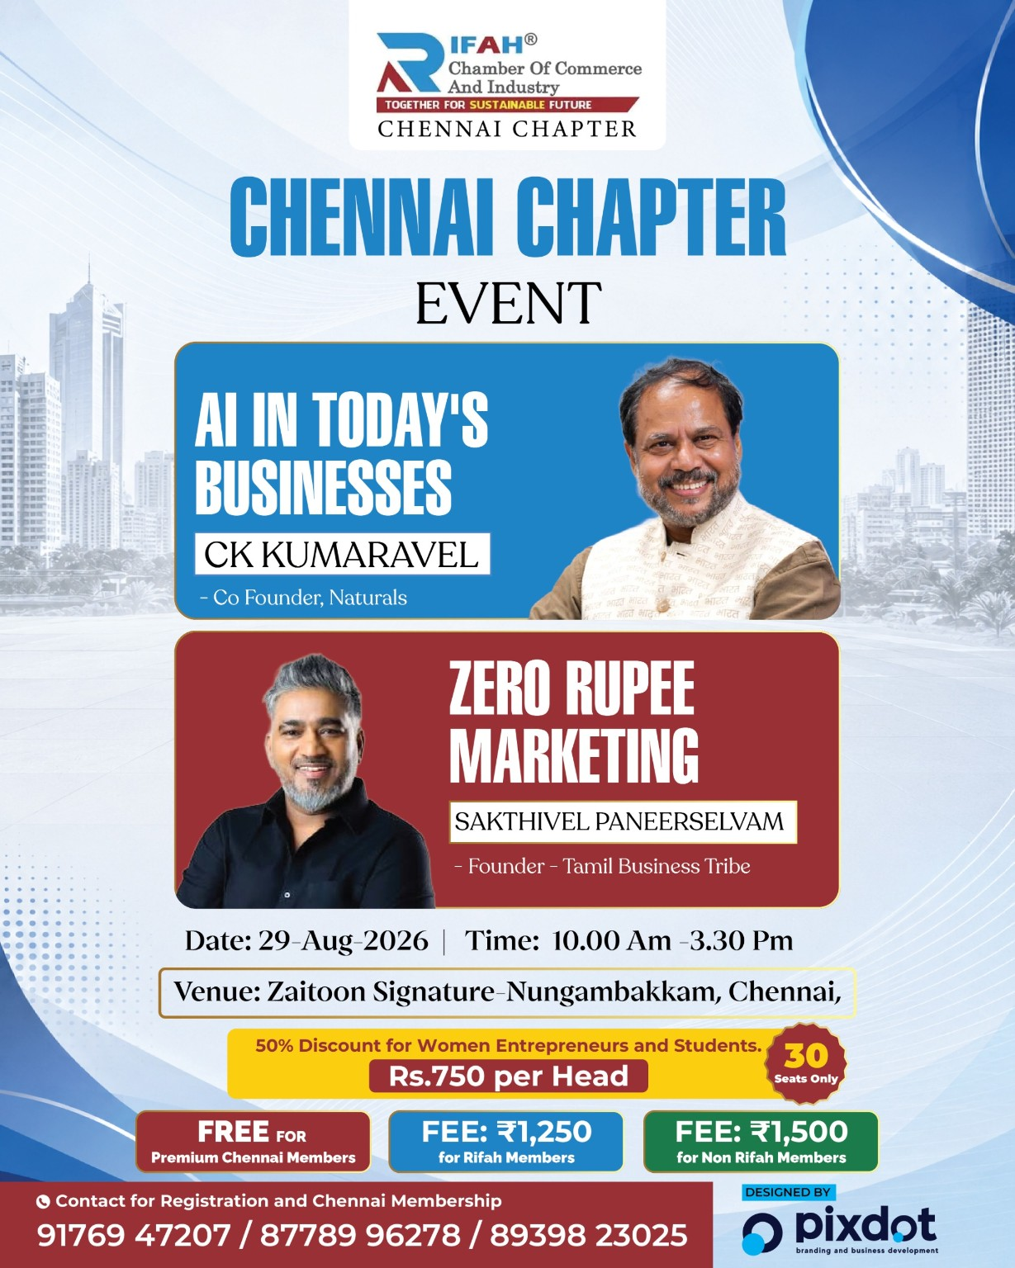
RIFAH CHAMBER OF COMMERCE & INDUSTRY
CHENNAI CHAPTER
2ND EVENT, 2026
FROM INSPIRATION → ACTION → IMPACT
29 AUGUST 2026 | Zaitoon Signature, Nungambakkam
Event Learning & Impact Report
AI IN TODAY’S BUSINESS • ZERO RUPEE MARKETING
RIFAH CHAMBER OF COMMERCE & INDUSTRY • CHENNAI CHAPTER
1

Slide 2
THE EVENT IN ONE VIEW
29 AUG 2026
A day that moved members from listening to doing.
Two practical sessions. One shared message: adapt, act, and build.
NEW PARTICIPANTS
PREMIUM MEMBERS
NEW MEMBERSHIPS
80
31
8
Entrepreneurs & members
Premium members participation
New memberships generated
THE CORE IMPACT
Mindset shifted • AI Simplified • Content created • New relationships built
• Membership pipeline strengthened
RIFAH CHAMBER OF COMMERCE & INDUSTRY • CHENNAI CHAPTER
2

Slide 3
WHY RIFAH CREATED THIS PLATFORM
PURPOSE
Not just an event — a platform for business transformation.
LEARN
APPLY
CONNECT
Expose members to practical ideas from proven business leaders.
Turn learning into immediate action — create, post, test, improve.
Strengthen the business community and create new membership momentum.
The strongest events do not end when the applause ends.
Their success is measured by what people do differently afterwards.
RIFAH CHAMBER OF COMMERCE & INDUSTRY • CHENNAI CHAPTER
3

Slide 4
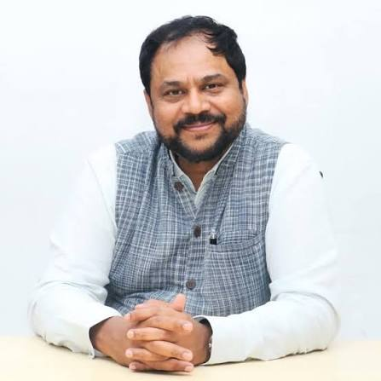
SESSION 01 — AI IN TODAY’S BUSINESS
C K KUMARAVEL
“AI is not for coders. It is for leaders.”
A catalyst session that challenged the audience with uncomfortable questions and practical possibilities.
• What should our community improve?
• Don’t fear AI — understand how it changes customers, work and competition.
• The 21st century is an opportunity for Indian industry.
• Believe in yourself and aim beyond today’s scale.
• Think boldly: Have a goal of ₹10,000 crore, that ambition requires people, systems and technology.
THE CHALLENGE
Stop asking
“Will AI replace me?”
Start asking “How can AI multiply me?”
RIFAH CHAMBER OF COMMERCE & INDUSTRY • CHENNAI CHAPTER
4

Slide 5
WHAT AI CAN DO FOR A BUSINESS
PRACTICAL TAKEAWAYS
From daily efficiency to future growth
UNDERSTAND
AUTOMATE
PREDICT
Changing customer needs & behavior
Routine daily tasks and repetitive work
Signals that help anticipate the future
PERSONALISE
SCALE
Offers, communication and customer experience
Build repeatable systems that can grow
Leadership question: “Which 3 tasks in my business should become AI-assisted this month?”
RIFAH CHAMBER OF COMMERCE & INDUSTRY • CHENNAI CHAPTER
5

Slide 6
A QUESTION WE MUST TAKE BACK
COMMUNITY REFLECTION
What should our business community improve?
The session was deliberately uncomfortable — because growth starts with honest questions.
• Create more opportunities for women to lead and build.
• Build a culture that welcomes new technology instead of fearing it.
• Move from discussion to measurable action in our businesses.
• Use Rifah as a platform for continuous learning, collaboration and growth.
70%
Women’s contribution
highlighted in the session
The bitter truth is useful only when it becomes a better action.
RIFAH CHAMBER OF COMMERCE & INDUSTRY • CHENNAI CHAPTER
6

Slide 7
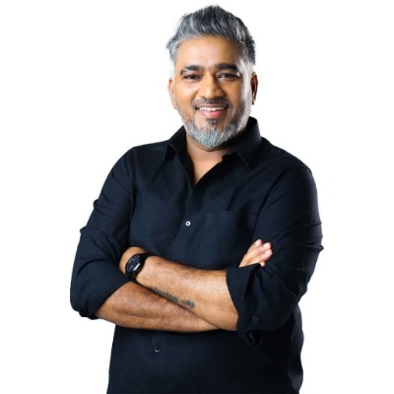
SESSION 02 — ZERO RUPEE MARKETING
SAKTHIVEL PANEERSELVAM
Marketing is all about Lateral Thinking
A practical, high-energy session on confidence, content and creative marketing.
• Breathing exercise before a sales pitch — control your state before you speak.
• Never let other people’s opinions become the limit on your action.
• Do what you love — authenticity makes content easier to sustain.
• Create content consistently: the 365-day marketing challenge made consistency visible.
• Guerrilla marketing + lateral thinking = attention without a large budget.
THE LIVE ACTION
Members created a video
and posted it on Instagram.
RIFAH CHAMBER OF COMMERCE & INDUSTRY • CHENNAI CHAPTER
7

Slide 8
THREE MARKETING IDEAS TO TAKE TO WORK
ZERO RUPEE MARKETING
The goal is not to spend more. The goal is to think differently.
GUERRILLA MARKETING
LATERAL THINKING
CONTENT CONSISTENCY
Create disproportionate attention with creativity, timing and context.
Break the obvious pattern. Change the question, angle or method.
Build trust by showing up repeatedly — not occasionally by posting daily video.
Marketing exercise: “How can I make my customer stop, look, remember and share?”
RIFAH CHAMBER OF COMMERCE & INDUSTRY • CHENNAI CHAPTER
8

Slide 9
FROM LEARNING TO ACTION
30-DAY CHALLENGE
Turn the event into a 30-day business experiment.
01
02
03
04
05
CHOOSE
→
CREATE
→
TEST
→
MEASURE
→
SHARE
Pick one routine task to AI-assist.
Publish 3 pieces of useful content in a week.
Try one guerrilla / lateral idea in a month.
Track response, leads, sales or time saved.
Bring the learning back to the Rifah community.
A learning community becomes powerful when members return with results — not just notes.
RIFAH CHAMBER OF COMMERCE & INDUSTRY • CHENNAI CHAPTER
9

Slide 10
RIFAH CHENNAI CHAPTER
DON’T JUST ATTEND.
TRANSFORM.
Learn something. Apply it. Share the result. Help another entrepreneur grow.
LEARN
ACT
GROW
1
Stay curious.
2
Take the first step.
3
Build together.
TOGETHER FOR A SUSTAINABLE FUTURE
RIFAH CHAMBER OF COMMERCE & INDUSTRY • CHENNAI CHAPTER
17

